Slide 1

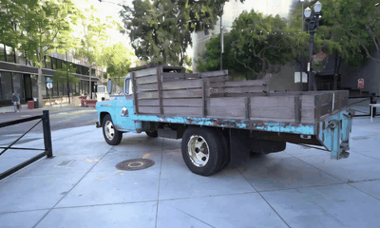
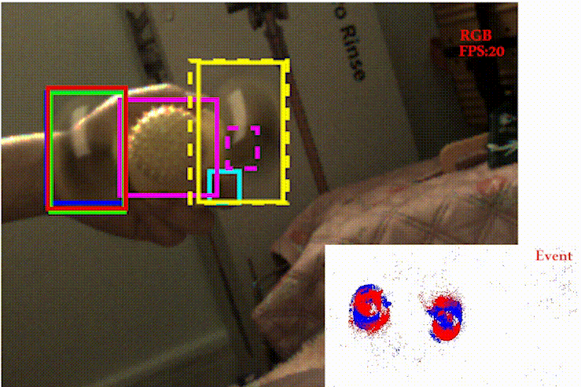
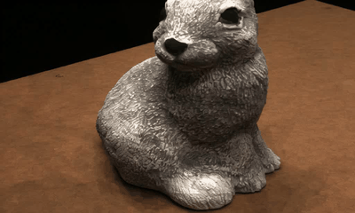
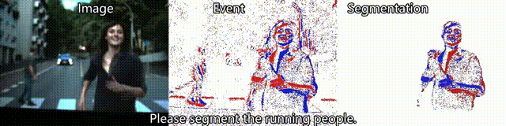
CS5187: Vision & Image
Instructor: Zhu Zhiyu

Slide 2
Instructor
Zhu Zhiyu (zhiyu.zhu@cityu.edu.hk)
Research interests:
  Computer vision and computational imaging
  Machine learning (Generative models)

Slide 3
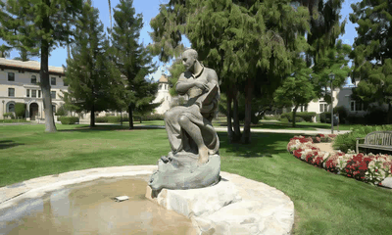
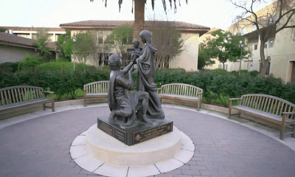
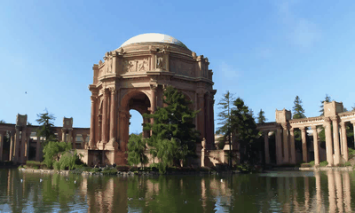
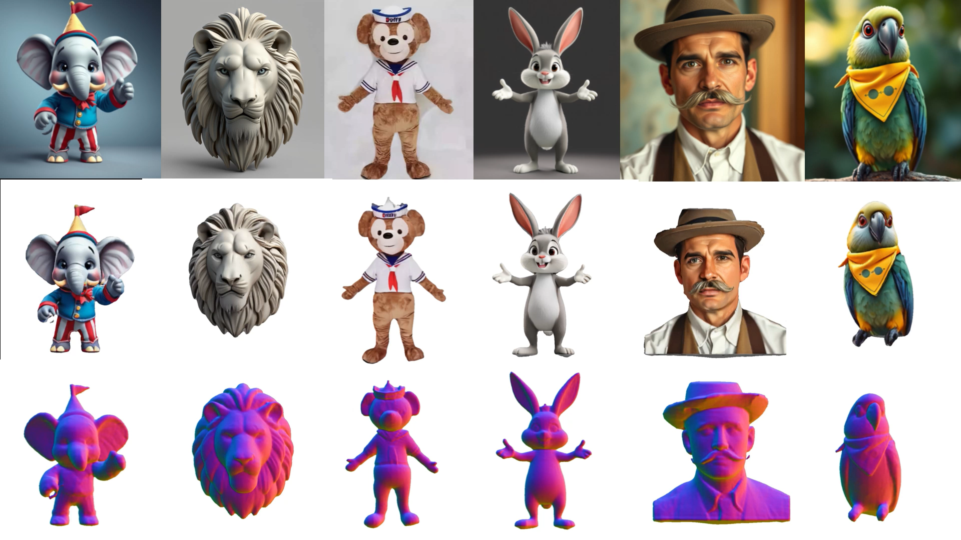
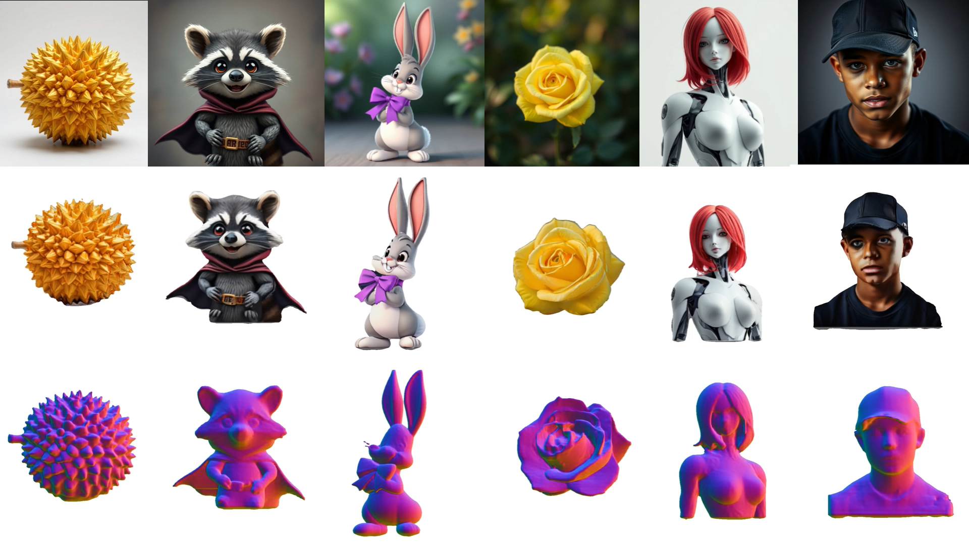
My research work
Novel view Synthesis from single static images
3D content generation

Slide 4
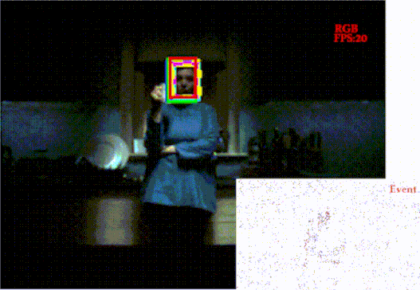
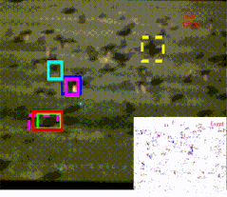
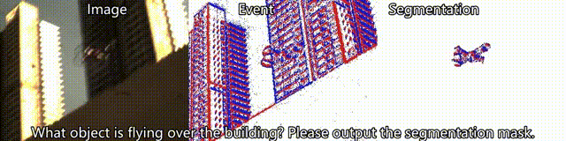
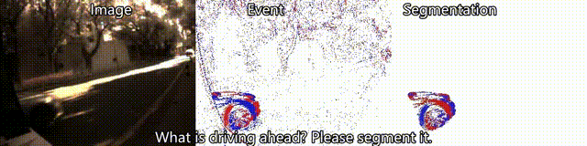
My research work
Object tracking & detection

Slide 5
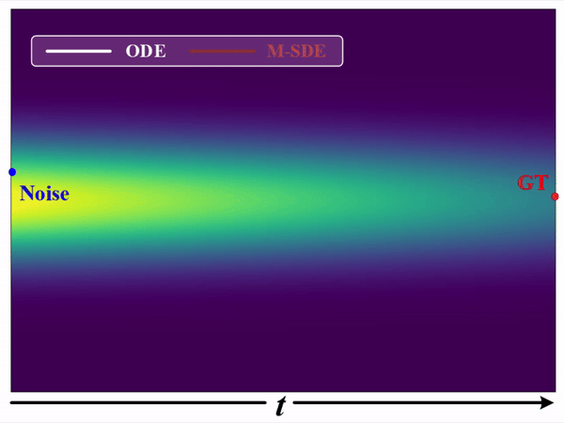
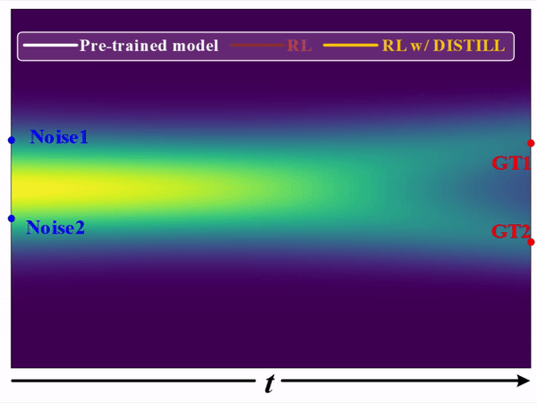
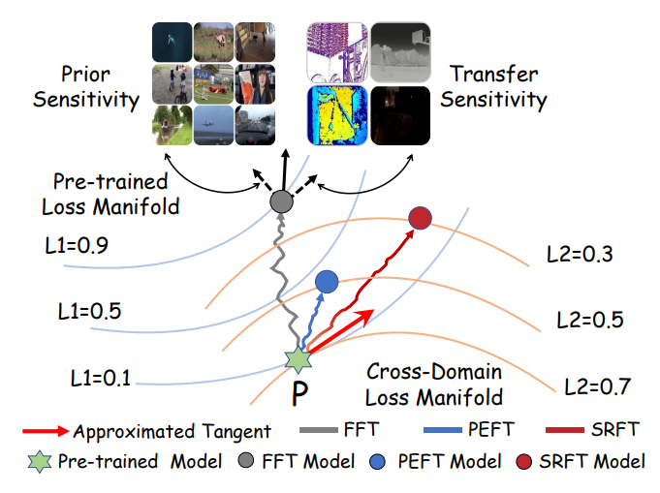

My research work
Generative models & network learning theory

Slide 6
Today
What is computer vision?
Why study computer vision?
Course overview
Images & image filtering [time permitting]

Slide 7
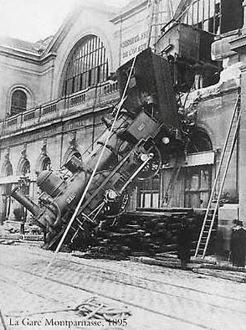
Every image tells a story
Goal of computer vision: perceive the “story” behind the picture
Compute properties of the world
  3D shape
  Names of people or objects
  What happened?

Slide 8
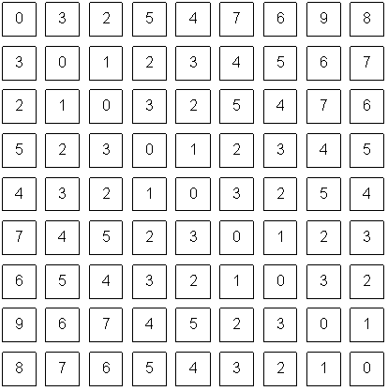
The goal of computer vision

Slide 9
Can computers match human perception?
Yes and no
  humans are better at “hard” things, are more robust, and make inferences quickly and cheaply
But huge progress
  Accelerating in the last 10 years due to deep learning, large vision-language models
  What is considered “hard” keeps changing

Slide 10
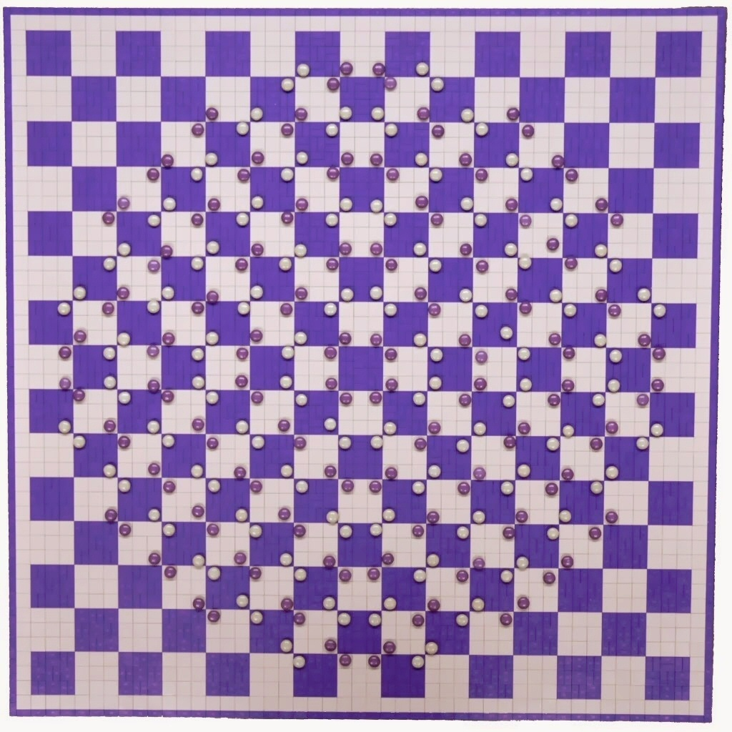
Human perception has its shortcomings
https://twitter.com/pickover/status/1460275132958662657/

Slide 11


But humans can tell a lot about a scene from a little information…
Source: “80 million tiny images” by Torralba, et al.

Slide 12
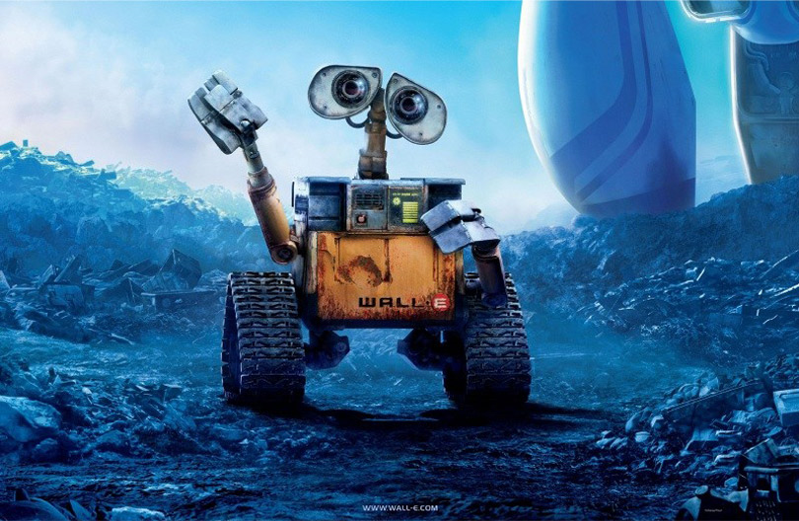
The goal of computer vision

Slide 13
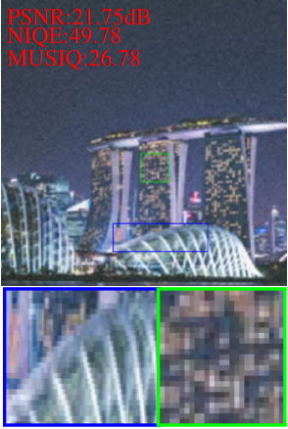
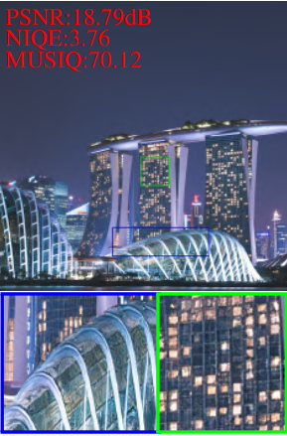
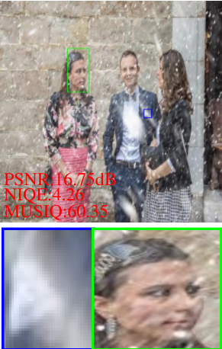
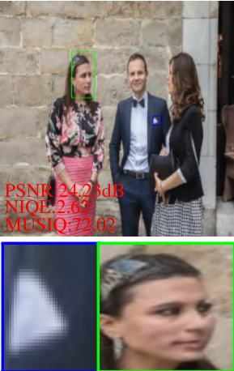
The goal of computer vision
“Enhance” images

Slide 14
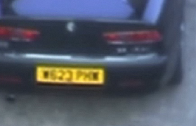
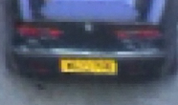
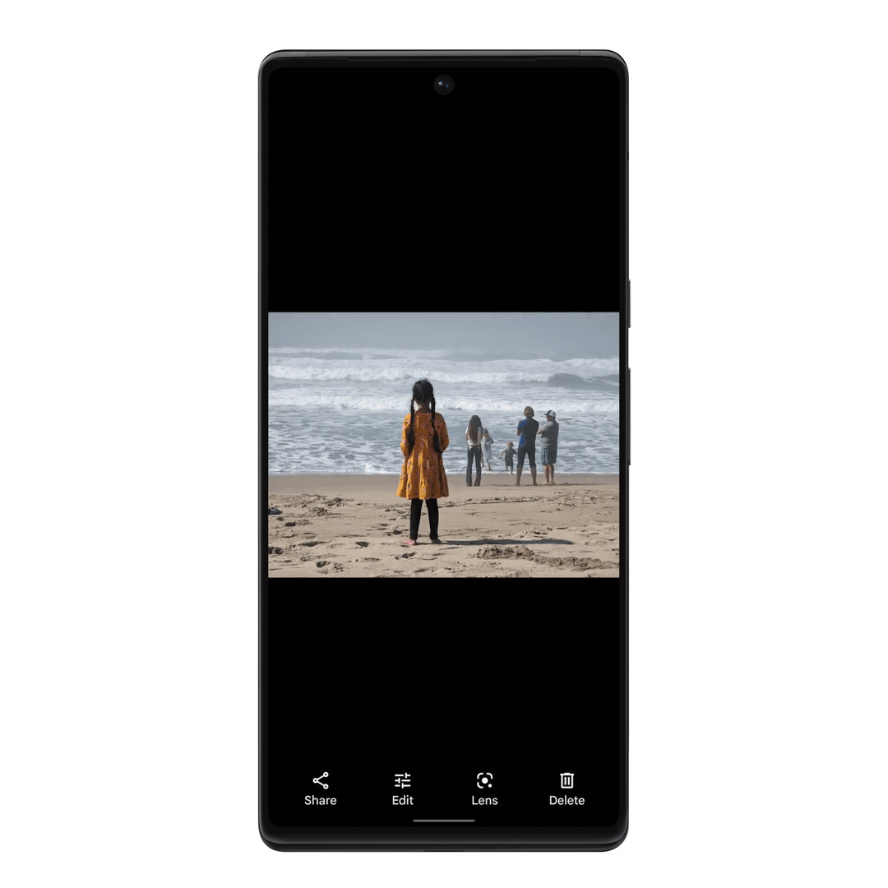
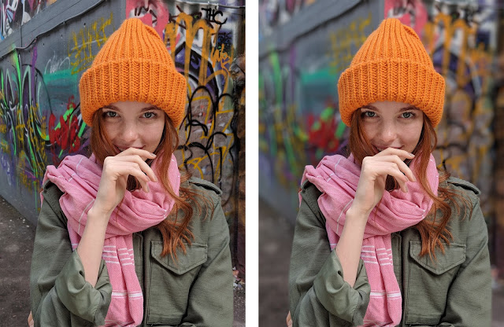
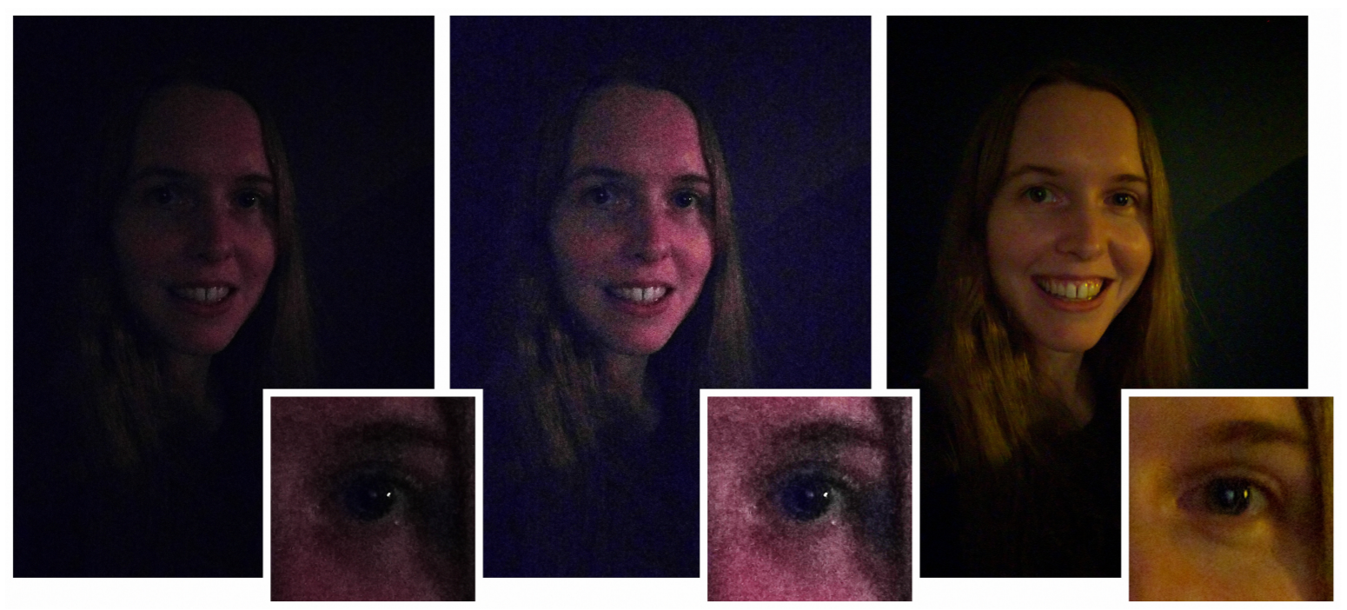
The goal of computer vision
“Enhance” images
Super-resolution (source: 2d3)
Depth of field on cell phone camera (source: Google Research Blog)
Removing objects (Google Magic Eraser)
Low-light photography
(credit: Hasinoff et al., SIGGRAPH ASIA 2016)

Slide 15
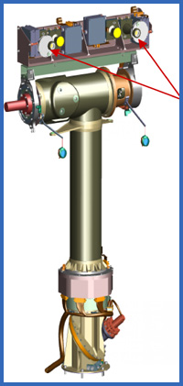
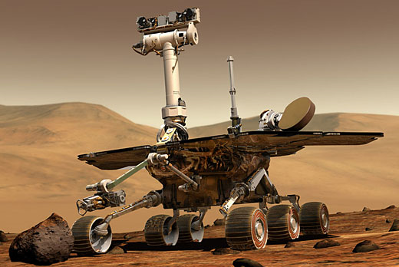
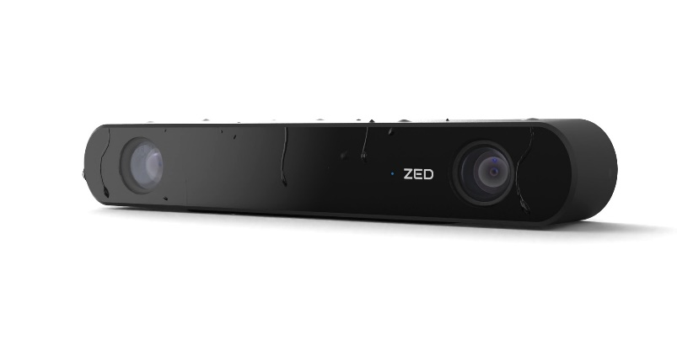
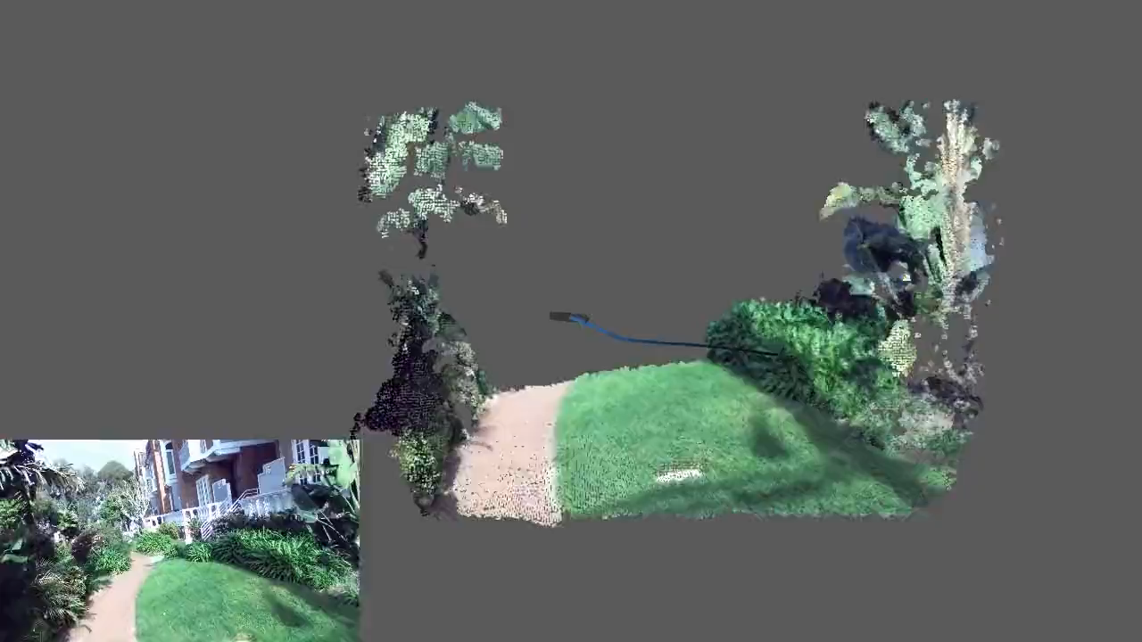
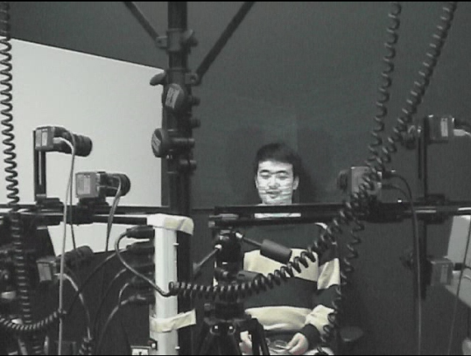
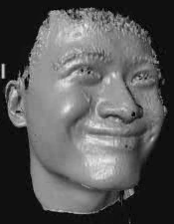
The goal of computer vision
Compute the 3D shape of the world
ZED 2i Camera

Slide 16
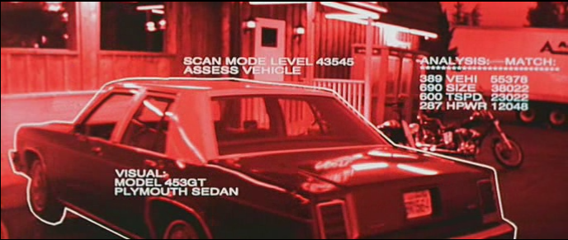
The goal of computer vision
Recognize objects and people
Terminator 2, 1991

Slide 17
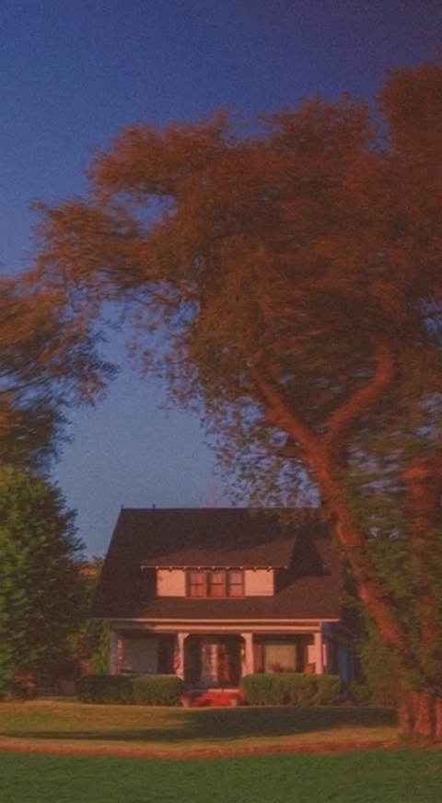
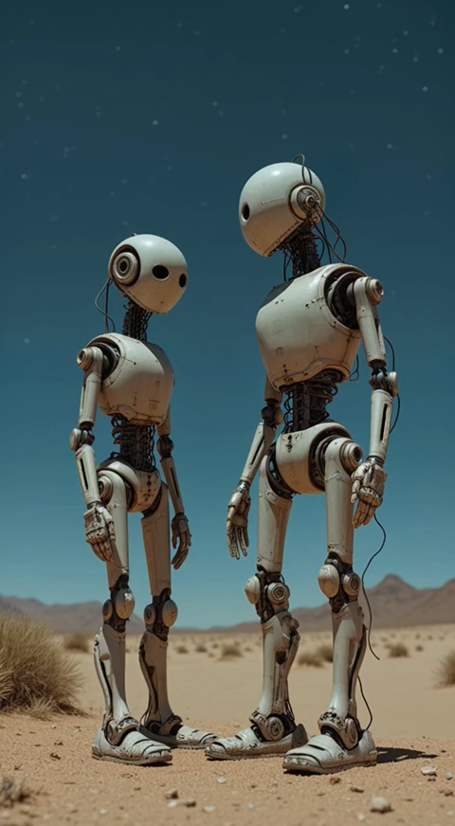
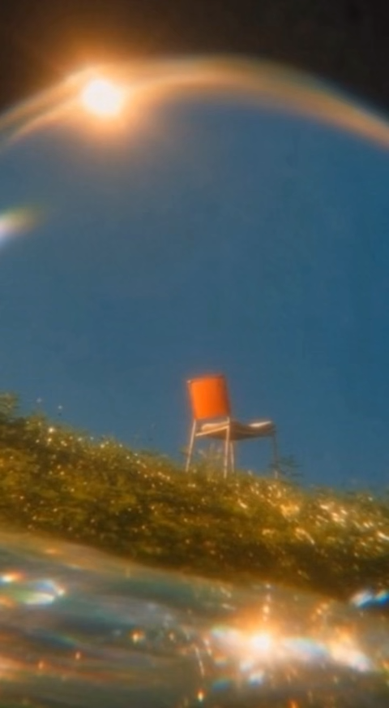

The goal of computer vision
Visual content generation.

Slide 18

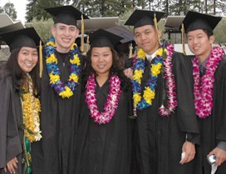
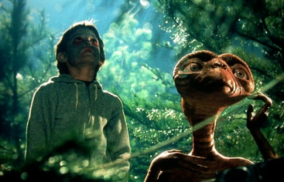

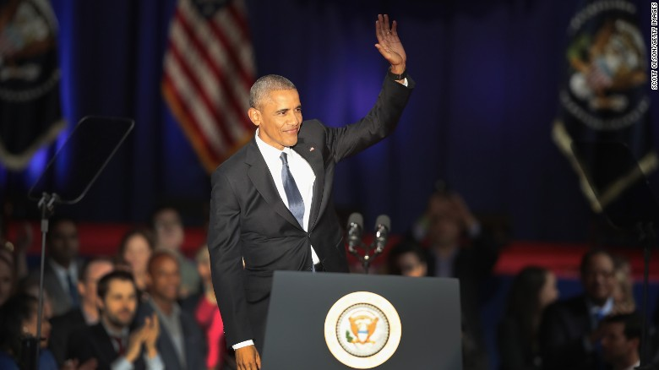
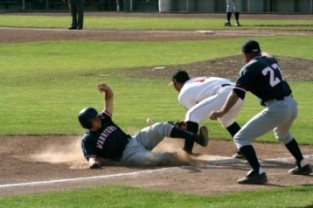
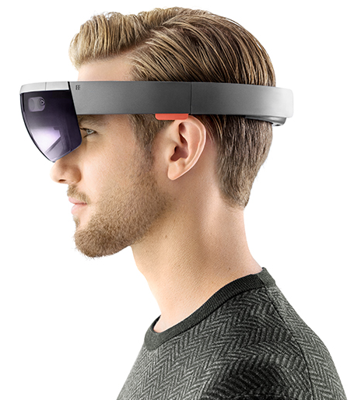






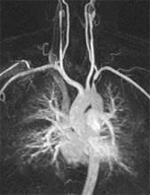
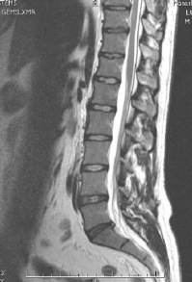
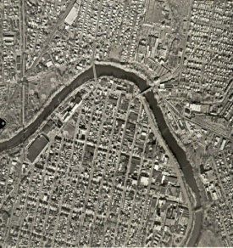
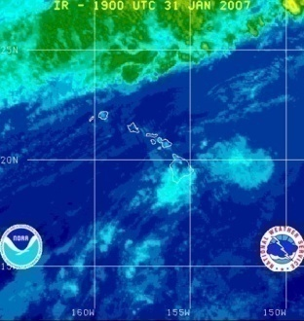

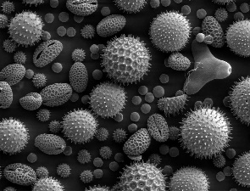
Why study computer vision?
Billions of images/videos captured per day
Huge number of potential applications
The next slides show the current state of the art

Slide 19
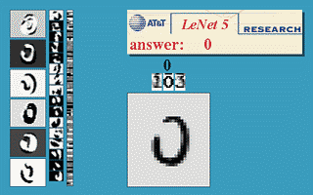




Optical character recognition (OCR)
  If you have a scanner, it probably came with OCR software
Digit recognition, AT&T labs (1990’s)
http://yann.lecun.com/exdb/lenet/
License plate readers
http://en.wikipedia.org/wiki/Automatic_number_plate_recognition
Sudoku grabber
http://sudokugrab.blogspot.com/
Automatic check processing

Slide 20

Face detection
Nearly all cameras detect faces in real time
  (Why?)
Notes:
Why would this be useful? Main reason is focus. Also enables “smart” cropping.

Slide 21

Face analysis and recognition

Slide 22

Vision-based biometrics
Who is she?
Source: S. Seitz

Slide 23



Vision-based biometrics
“How the Afghan Girl was Identified by Her Iris Patterns” Read the story
Source: S. Seitz

Slide 24


Login without a password
Fingerprint scanners on many new smartphones and other devices
Face unlock on Apple iPhone X
See also http://www.sensiblevision.com/

Slide 25


Special effects: motion capture
Pirates of the Carribean, Industrial Light and Magic
Source: S. Seitz

Slide 26


3D face tracking w/ consumer cameras
Snapchat Lenses
Face2Face system (Thies et al.)

Slide 27

Which face is real?
https://www.whichfaceisreal.com/

Slide 28


Image synthesis
“An astronaut riding a horse in a photorealistic style” – DALL-E 2
“A photo of a Corgi dog riding a bike in Times Square. It is wearing sunglasses and a beach hat” – Imagen

Slide 29


Sports
Sportvision first down line
Explanation on www.howstuffworks.com
Source: S. Seitz

Slide 30

Smart cars
Mobileye
Tesla Autopilot
Safety features in many cars

Slide 31

Self-driving cars
Waymo

Slide 32




Robotics
NASA’s Mars Curiosity Rover
https://en.wikipedia.org/wiki/Curiosity_(rover)
Amazon Picking Challenge
http://www.robocup2016.org/en/events/amazon-picking-challenge/
Amazon Prime Air
Amazon Scout

Slide 33


Medical imaging
3D imaging (MRI, CT)
Skin cancer classification with deep learning https://cs.stanford.edu/people/esteva/nature/

Slide 34




Virtual & Augmented Reality
6DoF head tracking
Hand & body tracking
3D scene understanding
3D-360 video capture

Slide 35
Current state of the art
You just saw many examples of current systems.
  Many of these are less than 10 years old
Computer vision is an active research area, and rapidly changing
  Many new apps in the next 5 years
  Deep learning and generative methods powering many modern applications
Many startups across a dizzying array of areas
  Generative AI, robotics, autonomous vehicles, medical imaging, construction, inspection, VR/AR, …

Slide 36







Why is computer vision difficult?
Viewpoint variation
Credit: Flickr user michaelpaul
Scale
Illumination

Slide 37






Why is computer vision difficult?
Motion (Source: S. Lazebnik)
Intra-class variation
Background clutter
Occlusion

Slide 38




Challenges: local ambiguity
slide credit: Fei-Fei, Fergus & Torralba

Slide 39

But there are lots of visual cues we can use…
Source: S. Lazebnik

Slide 40
CS5187: Vision and Image
Project-based course whose goal is to teach you the fundamentals of computer vision – image processing, geometry, recognition – in a hands-on way
This course covers fundamentals, including mathematical fundamentals. It is not a course specifically on deep learning or generative AI, though those topics will be covered.

Slide 41
Course requirements
Prerequisites
  Data structures
  Good working knowledge of Python programming
  Linear algebra
  Vector calculus
Course does not assume prior imaging experience
  computer vision, image processing, graphics, etc.

Slide 42




Course overview (tentative)
We generally have 13 classes.
3 Classes
20/01/2026 - 03/02/2026
10 classes
03/03/2026 - 09/05/2026
Low-level vision (2-3 classes)
  image processing, edge detection, feature detection, cameras, image formation
Geometry & appearance (3-4 classes)
  projective geometry, stereo, structure from motion, optimization, lighting & materials
Recognition & generative models (6-8 classes)
  object classification, deep learning, diffusion models

Slide 43
Course overview (tentative)
We generally have 13 classes.
Low-level vision (2-3 classes)
  image processing, edge detection, feature detection, cameras, image formation
Geometry & appearance (3-4 classes)
  projective geometry, stereo, structure from motion, optimization, lighting & materials
Recognition & generative models (6-8 classes)
  object classification, deep learning, diffusion models

Slide 44







1. Low-level vision
Basic image processing and image formation
*
=
Filtering, edge detection
Feature extraction
Image formation

Slide 45





2. Geometry & appearance
Image credit: IDS Imaging
Projective geometry
Stereo vision
Multi-view stereo
Structure from motion

Slide 46



3. Recognition & Generative Models
“dog”
Image classification
Convolutional Neural Networks
“a class watching a computer vision lecture”
Image generation

Slide 47
Lectures
Lectures will be held in person in AC5-514
If there is an instance where you cannot attend the class, please reach out to the instructor for approval
No conversations during class, please!

Slide 48
Grading
One midterm (between the 2nd and 3rd sections), and one final exam (in class)
Grade breakdown (subject to minor tweaks):
  Assignment : 40% = (Midterm: 30% + In-Class Quiz 10%)
  Programming projects (2 projects): 10%
  Final exam: 50%

Slide 49
Academic Integrity
Assignments will be done in pairs
Please do not leave any code public on GitHub (or the like) at the end of the semester!
If you use ChatGPT (or CoPilot, or similar) on coding assignments, you must disclose that with your submission
  BUT: We advise you to do all coding yourself.

Slide 50
Questions?

